Slide 1
Welcome! Database Development and Design
Developing and Design of databases using SQL Server

Slide 2

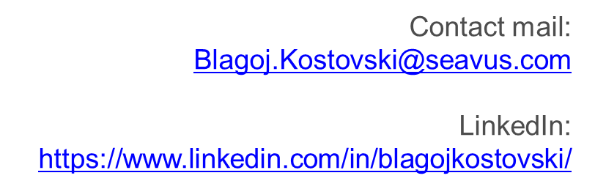
About Me
Education
Master degree – FINKI (2008-2012)
Bachelor’s degree – FEIT (2003-2008)
Working Experience
Seavus Group ( 2013 – Ongoing)
Komercijalna Banka (2008-2013)
Ultra doo (2007-2008)
Current job position
Technical lead at Seavus

Slide 3

About Me
Solution Architect with 15 years’ experience in designing and developing systems using Microsoft technologies.
Extensive experience in Microsoft SQL Server database platform (database design and implementation), with expertise in SQL standards, Transact/SQL, DWH, ETL, Integration Services, Reporting Services.
Extensive experience in Microsoft .NET development, proficient at identifying and resolving technical problems.
Contact mail:
mpusev@gmail.com
LinkedIn profile: https://www.linkedin.com/in/marjan-pusev/
Education
Graduated Engineer in Informatics
University "St. Cyril and Methodius“ (2000 - 2006)
Working Experience
Seavus (2018 - Ongoing) - Senior Database Developer
EVN (2006 - 2018) - Solution Architect
University "St. Cyril and Methodius“ (2004 - 2007) - Teaching Assistant

Slide 4
Major course intro
Understanding the Core Database Concepts
Database Server, Database, Data Types, DDL, DML
INSERT, UPDATE, DELETE
Querying data
Select statements, Filtering, Sorting, Unions, Joins
Foreign keys
Advanced querying
Aggregate functions, Grouping data, Views
Database routines
Stored procedures, Functions
Error handling and Basic Administration
Triggers and Constraints, Error handling
Users, Permissions, Roles

Slide 5
Agenda
Session 1
Database concepts and usage
Types of databases
Key terminology (DDL and DML statements)
Demo 1 - DDL and DML
Introduction to SSMS (SQL Server Management Studio)
Data types
Demo 2 – Data types
CRUD Operations (Create, Read, Update, Delete)
Create, Insert, Update, Delete
Client requirement – Orders system
Workshop – Creating tables
Knowledge check (Quiz, Discussion, Homework)
Session 2
Session 3
Session 4
Session 5
Session 6
Session 7

Slide 6
Session 1

Slide 7
Database concepts and usage

Slide 8
Database definitions 1/2
Cambridge dictionary
A large amount of information stored in a computer system in such a way that it can be easily looked at or changed
Wikipedia
Database is an organized collection of data, generally stored and accessed electronically from a computer system. Where databases are more complex they are often developed using formal design and modeling techniques.
Britannica
Database, also called electronic database, any collection of data, or information, that is specially organized for rapid search and retrieval by a computer. Databases are structured to facilitate the storage, retrieval, modification, and deletion of data in conjunction with various data-processing operations.

Slide 9
Database definitions 2/2
Database consists of logically related data stored in a single repository
Provides advantages over file system management approach
Eliminates inconsistency, data anomalies, data dependency, and structural dependency problems
Stores data structures, relationships, and access paths

Slide 10
Example of an old traditional database application
Suppose we are building a system to store the information about:
Customers
Products
Orders

Slide 11
Can we do it without DBMS?
Sure we can! Start by storing the data in files:
Customer.txt Product.txt Order.txt
Now write C or Java programs to implement specific tasks

Slide 12
Doing it without DBMS
Perform an order: “Customer A” orders “Product A”
Write a C program to do the following:
Read ‘Customer.txt’
Read ‘Product.txt’
Write in ‘Orders.txt’ - “Customer A orders Product A”
Write in “Product.txt” - “Product A” has changed available quantity

Slide 13
Problems without DBMS
CRASH !
System crashes:
What is the problem ?
Large data sets (Millions of Customers and Products)
What is the problem ?
Concurrent access by many users
Multiple users want to place an order in a same time. Multiple requests for write to Orders data file
Read ‘Customer.txt’
Read ‘Product.txt’
Write in ‘Orders.txt’ - “Customer A orders Product A”
Write in “Product.txt” - “Product A” has changed available quantity

Slide 14
Importance of DBMS
Makes data management more efficient and effective
Query language allows quick answers to ad hoc queries
Provides better access to more and better-managed data
Promotes integrated view of organization’s operations
Reduces the probability of inconsistent data

Slide 15
Types of databases

Slide 16
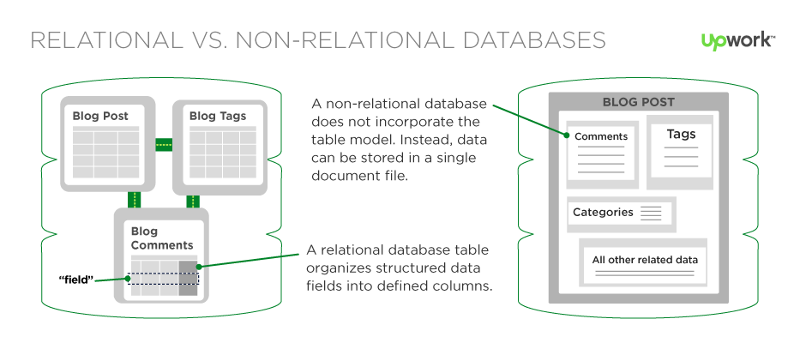
Types of databases 1/3
Relational databases (SQL)
Non-Relational databases (NoSQL)

Slide 17
Types of databases 2/3
SQL | NoSQL
RELATIONAL DATABASE MANAGEMENT SYSTEM (RDBMS) | Non-relational or distributed database system
These databases have fixed or static or predefined schema | They have dynamic schema
These databases are not suited for hierarchical data storage | These databases are best suited for hierarchical data storage.
These databases are best suited for complex queries | These databases are not so good for complex queries
Vertically Scalable | Horizontally scalable

Slide 18
Types of databases 3/3
Relational databases (SQL)
Structured (table based)
Most popular vendors
SQL Server , Oracle, MySQL, PostgreSQL
Non-Relational databases (SQL)
Non structured
Document based
Key-value pairs
Graph databases
Wide column stores
Most Popular vendors
MongoDB, Cassandra, Hbase, CoachDB

Slide 19
Introduction to SSMS

Slide 20
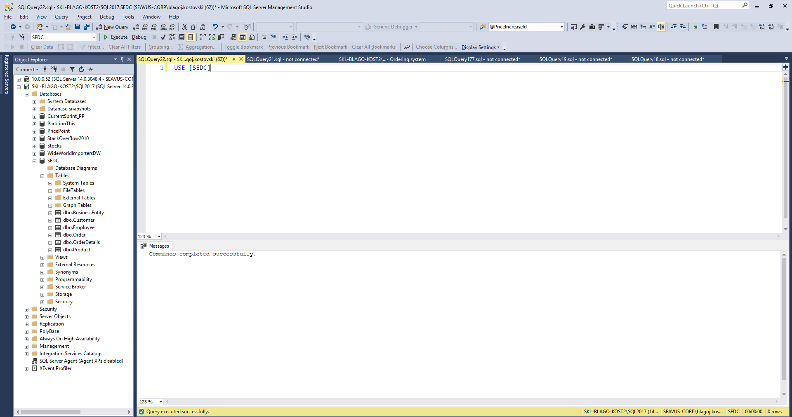

Slide 21
Key terminology

Slide 22
Key database terminology 1/2
Data Definition Language (DDL) is a subset of the Transact-SQL language; it deals with creating database objects like tables, constraints, and stored procedures. The interface used to create these underlying DDL statements is the SSMS user interface.
The six main DDL statements are as follows:
USE: Changes the database context.
CREATE: Creates a SQL Server database object (table, view, or stored procedure).
ALTER: Changes an existing object.
DROP: Removes an object from the database.
TRUNCATE: Removes rows from a table and frees the space used by those rows.
DELETE: Remove rows from a table but does not free the space used by those rows removed.

Slide 23
Key database terminology 2/2
Data Manipulation Language (DML) is the language element that allows you to use the core statements INSERT, UPDATE and DELETE to manipulate data in any SQL Server tables. Core DML statements include the following:
SELECT: Retrieves rows from the database and enables the selection of one or many rows or columns from one or many tables in SQL Server.
INSERT: Adds one or more new rows to a table or a view in SQL Server.
UPDATE: Changes existing data in one or more columns in a table or view.
DELETE: Removes rows from a table or view.

Slide 24
A table example terminology
Meta Data
Table Name
Field
Customer
Id | Name | Acct | City | Size | Active
1. | Vero | 12235 | Skopje | 1000 | 1
2. | Tinex | 43253 | Bitola | 2000 | 0
3. | Ramstore | 34534 | Ohrid | 1200 | 1
Record
Data

Slide 25
Demo 1 - DDL and DML
Session 1 – 01 Create table.xlsx
Session 1 – 02 DDL and DML.sql

Slide 26
Data types in SQL Server

Slide 27
Data types in SQL Server
Each column in a database table is required to have a name and a data type.
SQL data type is an attribute that specifies type of data of any object. Each column, variable and expression has related data type in SQL.
You would use these data types while creating your tables. You would choose a particular data type for a table column based on your requirement.
SQL developers have to decide what types of data will be stored inside each and every table column when creating a SQL table.
The data type is a label and a guideline for SQL to understand what type of data is expected inside of each column, and it also identifies how SQL will interact with the stored data.

Slide 28
Data types in SQL Server
In SQL Server, each column, local variable, expression, and parameter have a related data type. A data type is an attribute that specifies the type of data that the object can hold: integer data, character data, monetary data, date and time data, binary strings, and so on.
Exact numeric | Unicode character strings
Approximate numeric | Binary strings
Date and time | Other data types
Character strings

Slide 29
Data types in SQL Server
Exact numeric
Data type | Range | Storage
bigint | -2^63 (-9,223,372,036,854,775,808) to 2^63-1 (9,223,372,036,854,775,807) | 8 Bytes
int | -2^31 (-2,147,483,648) to 2^31-1 (2,147,483,647) | 4 Bytes
smallint | -2^15 (-32,768) to 2^15-1 (32,767) | 2 Bytes
tinyint | 0 to 255 | 1 Byte
Data type | Range | Storage
Decimal(p,s) | 10^38 +1 to 10^38 – 1 (p-Precision , S-Scale) Example: Decimal(5,2) – max: 999,99 | Depends on Precision
Data type | Range | Storage
Money | -922,337,203,685,477.5808 to 922,337,203,685,477.5807 (-922,337,203,685,477.58 to 922,337,203,685,477.58 ) | 8 bytes
smallmoney | - 214,748.3648 to 214,748.3647 | 4 bytes

Slide 30
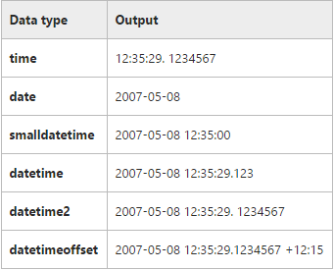
Data types in SQL Server
Approximate Numeric
Date and Time
date
datetimeoffset
datetime2
smalldatetime
datetime
time
n value | Precision | Storage size
1 - 24 | 7 digits | 4 bytes
25-53 | 15 digits | 8 bytes
Data type | Range | Storage
float | - 1.79E+308 to -2.23E-308, 0 and 2.23E-308 to 1.79E+308 | Depends on the value of n
real | - 3.40E + 38 to -1.18E - 38, 0 and 1.18E - 38 to 3.40E + 38 | 4 Bytes

Slide 31
Data types in SQL Server
Character Strings
char
varchar
text
Unicode Character Strings
nchar
nvarchar
Ntext

Slide 32
Data types in SQL Server
Binary Strings
binary
varbinary
image
text
Other Data Types
cursor
timestamp
hierarchyid
uniqueidentifier
sql_variant
xml
table
Spatial Types

Slide 33
Data types - Overview
References:
http://www.w3schools.com/sql/sql_datatypes.asp
https://msdn.microsoft.com/en-us/library/ms187752.aspx
https://docs.oracle.com/cd/B19306_01/server.102/b14200/sql_elements001.htm
http://dev.mysql.com/doc/refman/5.7/en/data-types.html
…
Hint: Always use official documentation when you design tables regarding the data types.

Slide 34
Demo 2 - Data types
Session 1 – 03 Format table.xlsx
Session 1 – 04 Data types.sql

Slide 35
CRUD operations
Create, Read, Update, Delete

Slide 36
CREATE operation 1/2
Create new data structure (Table, View, Function, Procedure, …)
Example:
CREATE TABLE [TableName] (
[Col1] [Data type 1],
[Col2] [Data type 2],
...
[ColN] [Data type N])
CREATE TABLE [Customer](
[Id] [int] NOT NULL,
[Name] [nvarchar](100) NOT NULL,
[City] [nvarchar](100) NULL)

Slide 37
Create operation 2/2
Primary key concept
Short, Not changeable, Incremental, Unique
Identity concept
CREATE TABLE [Customer](
[Id] [int] IDENTITY(1,1) NOT NULL,
[Name] [nvarchar](100) NOT NULL,
[City] [nvarchar](100) NULL,
CONSTRAINT [PK_Customer] PRIMARY KEY CLUSTERED
(
[Id] ASC
))
GO

Slide 38
INSERT operation
Insert new data
Example:
INSERT INTO [TableName] ([Col1],[Col2],...)
VALUES (Value1,Value2,...)
INSERT INTO [Customer] ([Id], [Name], [City])
VALUES (1, 'Vero Skopje', 'Skopje')
INSERT INTO [Customer] ([Id], [Name], [City])
VALUES (2, 'Vero Strumica', 'Strumica')

Slide 39
READ operation
Read all data in the table
Read only specific columns:
Read specific columns and Rows:
SELECT * FROM Customer
SELECT ID, Name, City
FROM Customer
SELECT ID, Name, City
FROM Customer
WHERE City = 'Skopje'

Slide 40
UPDATE operation
Update data
Example:
UPDATE [TableName]
SET Col1 = NewValue, Col2 = NewValue2,...
WHERE ColN = oldValue
UPDATE Customer
SET Name = 'Vero Bitola', City = 'Bitola'
WHERE Name = 'Vero Skopje'

Slide 41
DELETE operation
Delete data
Example:
DELETE
FROM [TableName]
WHERE ColN = oldValue
DELETE
FROM Customer
WHERE Name = 'Vero Skopje'

Slide 42
Client requirement – Orders system

Slide 43
The requirement
Client has 7 Business Entities based in the biggest cities in Macedonia
Client has around 100 Employees
Client has around 100 Customers (Legal Entities) in Macedonia
Client offers around 1000 different products on the market
Client business is based on the B2B (Business to Business) model
Core requirement:
System should be able to manage client orders
Each order should contain following information: Date, Status, Employee performing the order, Customer, Total amount of the order
Additionally for each order system should keep details about products, single product price and quantity per product included in the order
Lets find some company as an example – Vitalia
https://www.vitalia.com.mk/products-filter-page/

Slide 44
B2B model example
Vitalia Skopje
Vitalia Bitola
Vitalia Strumica
Vitalia Kumanovo
Vitalia Tetovo
Vitalia Stip
Vitalia Ohrid
Vitalia
Business Entity
Customers
Stokomak
Kit-Go
Zito market
Tinex

Slide 45
Workshop – Creating tables

Slide 46
Creating tables by using T-SQL
Create new database: SEDC
Create the following tables:
BusinessEntity
Employee
Product
Customer
Order
OrderDetails
Try to insert data in the tables

Slide 47
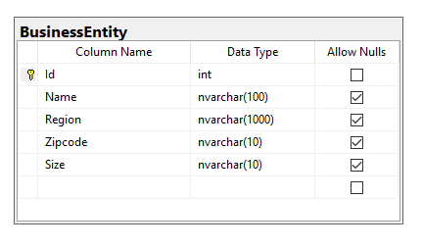
Create table - BusinessEntity
CREATE TABLE [dbo].[BusinessEntity](
[Id] [int] IDENTITY(1,1) NOT NULL,
[Name] [nvarchar](100) NULL,
[Region] [nvarchar](1000) NULL,
[Zipcode] [nvarchar](10) NULL,
[Size] [nvarchar](10) NULL,
CONSTRAINT [PK_BusinessEntity] PRIMARY KEY CLUSTERED
(
[Id] ASC
))

Slide 48
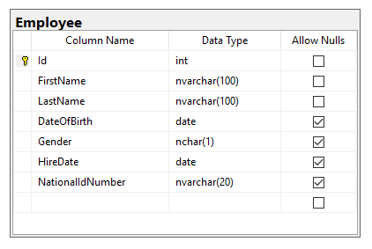
Create table - Employee
CREATE TABLE [dbo].[Employee](
[Id] [int] IDENTITY(1,1) NOT NULL,
[FirstName] [nvarchar](100) NOT NULL,
[LastName] [nvarchar](100) NOT NULL,
[DateOfBirth] [date] NULL,
[Gender] [nchar](1) NULL,
[HireDate] [date] NULL,
[NationalIdNumber] [nvarchar](20) NULL,
CONSTRAINT [PK_Employee] PRIMARY KEY CLUSTERED
(
[Id] ASC
))

Slide 49
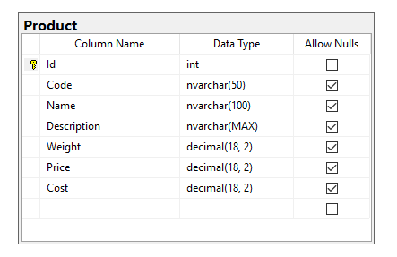
Create table - Product

Slide 50
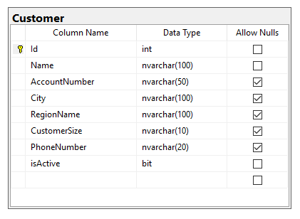
Create table - Customer

Slide 51
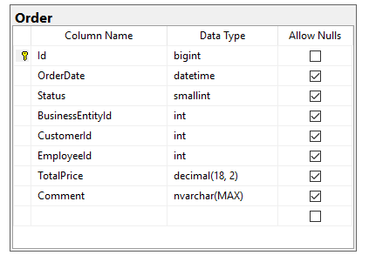
Create table - Order

Slide 52
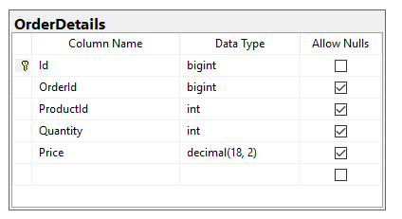
Create table - OrderDetails

Slide 53
Create tables with script
If there are any problems with the table creation provide full script
Session 1 workshop - 01 Create tables.sql

Slide 54

Knowledge check
Quiz, Discussion, Homework
https://sli.do/

Slide 55
Quiz
Which of the following is not a DDL statement?
a. CREATE
b. INSERT
c. ALTER
d. DROP
Which of the following is not a DML statement?
a. UPDATE
b. INSERT
c. CREATE
d. DELETE

Slide 56
Quiz
Which SQL statement is used to update data in a database?
a. SAVE
b. MODIFY
c. SAVE AS
d. UPDATE
Which of the following is not numeric data type?
a. bigint
b. decimal
c. nvarchar
d. money
Which of the following is not true about the int data type?
a. int is an integer
b. bigint is used when the value will exceed int data type’s range
c. An Integer uses 8 bytes to store data
d. Int can not store textual values

Slide 57
Quiz
What is the purpose of IDENTITY(1,1) statement in the table creation?
What is the purpose of ALLOW NULLS configuration in the table creation?

Slide 58
Homework 1

Slide 59
Homework requirement
Faculty has 88 Teachers
Faculty has hardcopy records for 569 Students (graduated and not graduated)
Faculty has 41 Courses in Curriculum
Faculty has several activities that students should achieve to pass the exam
Faculty has around 20000 records (Grades) for passed exams
Core requirement:
System should be able to manage Exams
Each Grade record should contain following information: Date, Student, Teacher, Course, Grade value
Additionally for each Grade, system should keep details about Achievement type (home work, exam, class activity…), achievement points, achievement maximum points and achievement date
Lets find some faculty as an example – FINKI
https://www.finki.ukim.mk/mk/dodiplomski-studii

Slide 60

SEDCHome – List of tables
Student
- ID
- FirstName
- LastName
- DateOfBirth
- EnrolledDate
- Gender
- NationalIDNumber
- StudentCardNumber
Course
- ID
- Name
- Credit
- AcademicYear
- Semester
Teacher
- ID
- FirstName
- LastName
- DateOfBirth
- AcademicRank
- HireDate
Grade
- ID
- StudentID
- CourseID
- TeacherID
- Grade
- Comment
- CreatedDate
GradeDetails
- ID
- GradeID
- AchievementTypeID
- AchievementPoints
- AchievementMaxPoints
- AchievementDate
AchievementType
- ID
- Name
- Description
- ParticipationRate

Slide 61
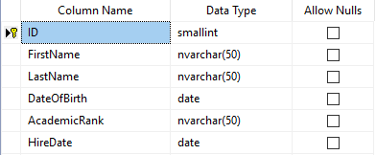
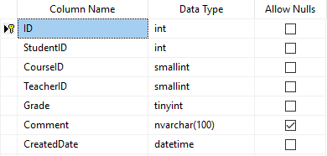
SEDCHome – Table example
Teacher
Grade

Slide 62
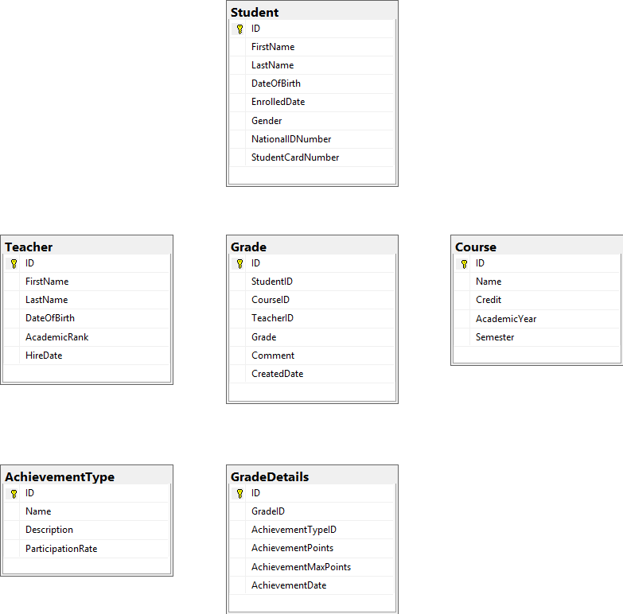

Slide 63
Session 2

Slide 64
Agenda
Session 2
Homework discussion
Filtering and Sorting data
Workshop
Combining sets (UNION, UNION ALL, INTERSECT)
Workshop
Table constraints (Default, Check, Unique)
Workshop
Referential integrity (Foreign Keys)
Workshop
Join Types (Left, Right, Inner, Cross Join)
Workshop
Knowledge check (Quiz, Discussion, Homework)

Slide 65
Homework discussion

Slide 66
Homework - solution
Present diagram with all tables
New database: SedcHOME
Provide create script (homework folder)
Provide Insert script (homework folder)

Slide 67
Filtering and Sorting data

Slide 68
Fill database with example data
Let’s populate the tables with example data
Execute script: Session 2 – 01 Insert example data in SEDC database.sql
NOTE: Do not go into details with this script – JUST RUN IT

Slide 69
Set Theory
T-SQL is based on strong mathematical foundations
Set theory
Predicate logic (True, False, Undefined)
T-SQL is based on multiset theory
Multiset (also known as a bag or superset) in many respects is similar to a set, but can have duplicates
DISTINCT clause removes duplicates

Slide 70
Filtering data
Filtering expressions are used to reduce number of rows returned based on some criteria
WHERE statement
Example:
Operators:
=, <, >, <>, <=, >=, BETWEEN, LIKE (%), IN, NOT, AND, OR
SELECT *
FROM [TableName]
WHERE [ColumnName] = Value
SELECT *
FROM Employee
WHERE FirstName = 'Aleksandar'

Slide 71
Filtering data - Workshop
Find all Employees with FirstName = Goran
Find all Employees with LastName starting With ‘S’
Find all Employees with DateOfBirth greater than ‘01.01.1988’
Find all Male employees
Find all employees hired in January/1998
Find all Employees with LastName starting With ‘A’ hired in January/2019

Slide 72
Sorting data
Ordering the results based on specific order
ORDER BY statement
Example:
SELECT *
FROM [TableName]
ORDER BY [ColumnName] ASC\DESC
SELECT *
FROM Employee
ORDER BY FirstName ASC

Slide 73
Sorting data - Workshop
Find all Employees with FirstName = Aleksandar ordered by Last Name
List all Employees ordered by FirstName
Find all Male employees ordered by HireDate, starting from the last hired

Slide 74
Combining sets
Union, Union ALL, Intersect

Slide 75
Combining sets - UNION
UNION set operator unifies the results of the two input queries. As a set operator, UNION has an implied DISTINCT property, meaning that it does not return duplicate rows.
Duplicates are eliminated
Pre-requisites
All sets should have same number of columns
Columns should be of same or compatible data type
Example:
Set1
Set2
SELECT FirstName,LastName
FROM Employee
UNION
SELECT FirstName,LastName
FROM Employee

Slide 76
Combining sets – UNION ALL
UNION ALL operator unifies the results of the two input queries. As a set operator, UNION ALL doesn’t has an implied DISTINCT property, meaning that it can return duplicate rows.
Duplicates remain
Pre-requisites
All sets should have same number of columns
Columns should be of same or compatible data type
Example:
Set1
Set2
SELECT FirstName,LastName
FROM Employee
UNION ALL
SELECT FirstName,LastName
FROM Employee

Slide 77
Combining sets – INTERSECT
INTERSECT operator returns only distinct rows that are common to both sets. In other words, if a row appears at least once in the first set and at least once in the second set, it will appear once in the result of the INTERSECT operator.
Pre-requisites
All sets should have same number of columns
Columns should be of same or compatible data type
Example:
Intersect
Set1
Set2
SELECT FirstName,LastName
FROM Employee
WHERE FirstName = 'Aleksandar'
INTERSECT
SELECT FirstName,LastName
FROM Employee
WHERE LastName = 'Nikolovski'
Except
Set1
Set2

Slide 78
Combining sets - Workshop
List all BusinessEntity Names and Customer Names in single result set with duplicates
List all regions where some BusinessEntity is based, or some Customer is based. Remove duplicates
List all regions where we have BusinessEntities and Customers in the same time

Slide 79
Table constraints
Default, Check, Unique

Slide 80
Table constraints - Default
The least constraining of all the T-SQL table constraints is the default constraint. In fact, you could say default constraints don't really constrain anything at all; they just supply a default value during an INSERT if no other value is supplied
Can be defined during the table creation
Table can be edited later on to support default constraint
Example:
Demo: Session 2 – 02 Default constraints.sql
alter table Product
add constraint DF_Product_Weight
default 100 for [Weight]
GO

Slide 81
Table constraints - Check
With a check constraint, you declare that the values of a column are constrained in some fashion.
The values are already constrained by the data type, so a check constraint adds some additional constraints on the ranges, or set of allowable values.
Example:
Demo: Session 2 – 03 Check constraints.sql
ALTER TABLE [dbo].[Product_test] WITH CHECK
ADD CONSTRAINT CHK_Products_Price
CHECK (price>=0);
GO

Slide 82
Table constraints - UNIQUE
Unique constraints guarantee that no more then one row can have the same value for specific column(s) in the table.
In the real world this constraints are used to prevent storing duplicate data for the same object (e.g. Table used to store the product can not have the same product inserted twice)
Example:
Demo: Session 2 – 04 Unique constraints.sql
ALTER TABLE [dbo].[Product] WITH CHECK
ADD CONSTRAINT UC_Code UNIQUE (Code)
GO

Slide 83
Table constraints - Workshop
Change Products table always to insert value 1 in price column if no price is provided on insert
Change Products table to prevent inserting Price that will more than 2x bigger then the cost price
Change Products table to guarantee unique names across the products

Slide 84
Referential integrity
Foreign keys

Slide 85
Foreign key
A foreign key is a column or combination of columns in one table that serve as a link to look up data in another table.
In the second table, often called a lookup table, the corresponding column or combination of columns have a primary key or unique constraint applied to them, or a unique index.
So a value in the first table may be duplicated, but in the second table where you look up the corresponding value, it must be unique
Example:
ALTER TABLE [dbo].[Order] WITH CHECK
ADD CONSTRAINT [FK_Order_BusinessEntity] FOREIGN KEY([BusinessEntityId])
REFERENCES [dbo].[BusinessEntity] ([Id])
GO

Slide 86
Foreign key - Workshop
How it works without keys
Add foreign key between BusinessEntity and Order with script
Open Ordering system diagram and add foreign keys manually
How it works with keys

Slide 87
Types of relations
Types of relations between tables
One-to-Many Relationship (1:M) – Most common
A one-to-many relationship is the most common type of relationship. In this type of relationship, a row in table A can have many matching rows in table B, but a row in table B can have only one matching row in table A. For example, one Customer can have many Orders, but one order is only for 1 Customer.
Many-to-Many Relationships (M:M)
In a many-to-many relationship, a row in table A can have many matching rows in table B, and vice versa. You create such a relationship by defining a third table - C, called a junction table, whose primary key consists of the foreign keys from both tables A and table B.
For example the BusinessEntity table and the Customer table both have 1:M relation with Orders table which makes the M:M relation.
One-to-One Relationships (1:1)
In a one-to-one relationship, a row in table A can have no more than one matching row in table B, and vice versa. Example is the Customer table we have PhoneNumber column which can be placed in different table - CustomerPhone.
Relations are also known as Foreign Key (FK) relations.

Slide 88
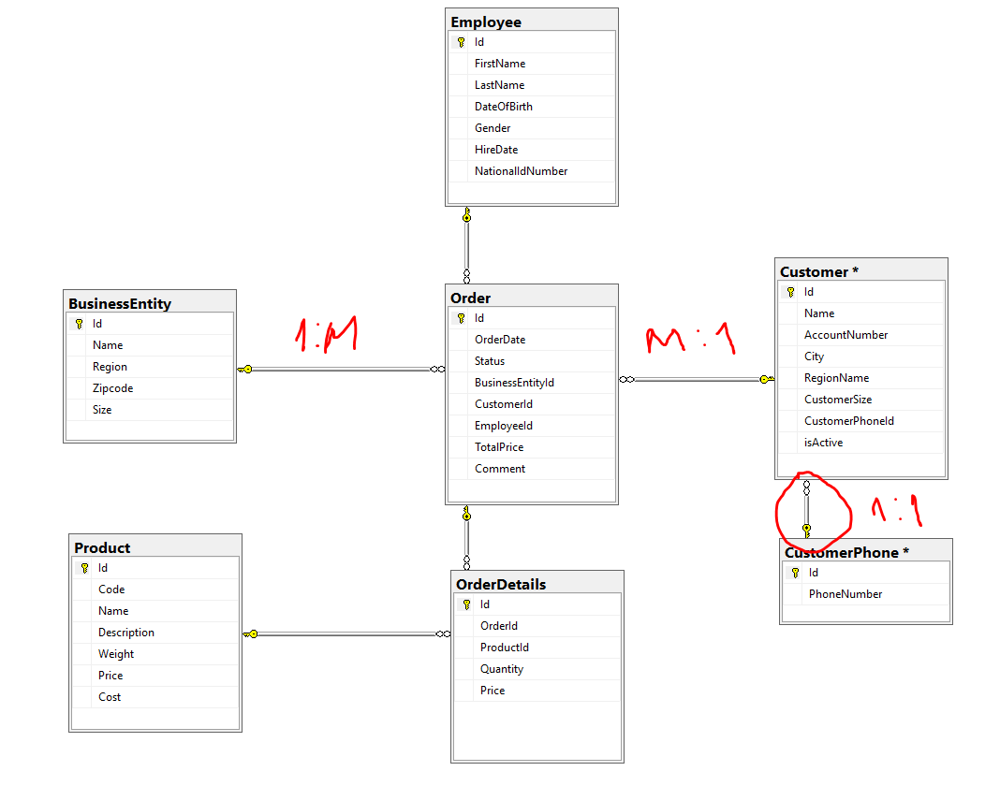
Types of relations - explained

Slide 89
Join types
Inner, Left, Right, Cross

Slide 90
Join types
Often, data that you need to query is spread across multiple tables. The more normalized the environment is, the more tables you usually have.
The tables are usually related through keys, such as a foreign key in one side and a primary key in the other. Then you can use joins to query the data from the different tables and match the rows that need to be related.
This lesson covers the different types of joins that T-SQL supports:
Cross
Inner
Outer (Left, Right, Full)

Slide 91
Join types – Cross join
A cross join is the simplest type of join, though not the most commonly used one. This join performs what’s known as a Cartesian product of the two input tables. In other words, it performs a multiplication between the tables, yielding a row for each combination of rows from both sides.
Table A
Table B
M x N rows
M rows
N rows

Slide 92
Join types – Inner join
With an inner join, you can match rows from two tables based on a predicate—usually one that compares a primary key value in one side to a foreign key value in another side.
Inner join returns only matching rows - rows that exists in both tables
Table A
Table B
M rows
N rows

Slide 93
Join types – Outer join
With outer joins, you can request to preserve all rows from one or both sides of the join, never mind if there are matching rows in the other side based on the ON predicate.
Types:
LEFT (OUTER) JOIN RIGHT (OUTER) JOIN FULL (OUTER) JOIN
Table A
Table B
Table A
Table B
Table A
Table B

Slide 94
Join types - Demo
Create two tables (TableA, TableB)
Insert 2 records in each with values (1,2) ,(2,3)
Show all join types on this example
Demo: Session 2 – 05 Join types.sql

Slide 95
Join types - Workshop
List all possible combinations of Customer names and Product names that can be ordered from specific customer
List all Business Entities that has any order
List all Entities without orders
List all Customers without orders (using Right Join and using Left join)

Slide 96
Knowledge check
Quiz, Discussion, Homework
https://sli.do/

Slide 97
Quiz
Which SQL statement filters the resultset with additional conditions?
a. ORDER
b. FILTER
c. WHERE
d. REMOVE
Which SQL statement defines how records are ordered in sort operations?
a. HIGHEST \ LOWEST
b. TOP \ BOTTOM
c. ASC \ DESC
d. FIRST \ LAST

Slide 98
Quiz
How to combine two result sets in order to have result containing all data from both tables without duplicates?
a. INTERSECT
b. UNION
c. EXCEPT
d. UNION ALL
Which type of constraint should be used in order to prevent having two or more same values in specific table column?
a. DEFAULT
b. CHECK
c. UNIQUE
d. DISTINCT
Which of the join types returns only records that exist in both tables?
a. CROSS JOIN
b. INNER JOIN
c. LEFT JOIN
d. FULL JOIN

Slide 99
Quiz
What is the purpose of Foreign keys?
Provide example from real world where CROSS JOIN type can be used?

Slide 100
Homework 2

Slide 101
Homework – pre-requisite
Provide script for inserting dummy data in already created SEDCHome database
Session 2 - 06 Insert example data in SEDCHome database - data.sql

Slide 102
Homework requirement 1/6
Find all Students with FirstName = Antonio
Find all Students with DateOfBirth greater than ‘01.01.1999’
Find all Male students
Find all Students with LastName starting With ‘T’
Find all Students Enrolled in January/1998
Find all Students with LastName starting With ‘J’ enrolled in January/1998

Slide 103
Homework requirement 2/6
Find all Students with FirstName = Antonio ordered by Last Name
List all Students ordered by FirstName
Find all Male students ordered by EnrolledDate, starting from the last enrolled

Slide 104
Homework requirement 3/6
List all Teacher First Names and Student First Names in single result set with duplicates
List all Teacher Last Names and Student Last Names in single result set. Remove duplicates
List all common First Names for Teachers and Students

Slide 105
Homework requirement 4/6
Change GradeDetails table always to insert value 100 in AchievementMaxPoints column if no value is provided on insert
Change GradeDetails table to prevent inserting AchievementPoints that will more than AchievementMaxPoints
Change AchievementType table to guarantee unique names across the Achievement types

Slide 106
Homework requirement 5/6
Create Foreign key constraints from diagram or with script

Slide 107
Homework requirement 6/6
List all possible combinations of Courses names and AchievementType names that can be passed by student
List all Teachers that has any exam Grade
List all Teachers without exam Grade
List all Students without exam Grade (using Right Join)

Slide 108
Session 3

Slide 109
Agenda
Session 3
Homework discussion
Grouping functions
Aggregate functions (Min, Max, Sum, Avg, Count)
Workshop
Filtering by grouped data
Workshop
Views
Workshop
Knowledge check (Quiz, Discussion, Homework)

Slide 110
Homework discussion

Slide 111
Grouping functions
Min, Max, Sum, Avg, Count, String_agg

Slide 112
Grouping functions
With grouped queries, you can arrange the rows you’re querying in groups and apply data analysis computations like aggregate functions against those groups.
A query becomes a grouped query when you use a group function, a GROUP BY clause, or both.
A query that invokes a group function but doesn’t have an explicit GROUP BY clause arranges all rows in one group. Consider the following query as an example:
SELECT COUNT(*) as Total
FROM dbo.Employee
SELECT Gender, COUNT(*) as Total
FROM dbo.Employee
GROUP BY Gender

Slide 113
Grouping functions
Numeric aggregation functions
COUNT
SUM
AVG
MIN
MAX
String aggregation functions
STRING_AGG

Slide 114
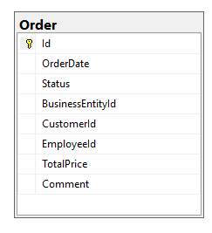
Grouping functions - Workshop
Calculate the total amount on all orders in the system
Calculate the total amount per BusinessEntity on all orders in the system
Calculate the total amount per BusinessEntity on all orders in the system from Customers with ID < 20
Find the Maximal Order amount, and the Average Order amount per BusinessEntity on all orders in the system
Suggest a question about some information that needs to be extracted from the Orders table

Slide 115
Filtering by grouped data
HAVING operator

Slide 116
Grouping functions – filtering by grouped data
Many often we need to perform search operations on already aggregated data
WHERE expression filter the resultset before grouping
HAVING operator is used to filter data after grouping
example:
SELECT Column1, fn(ColumnN)
FROM Table1
WHERE ColumnN condition
GROUP BY Column1
HAVING fn(ColumnN) condition
SELECT BusinessEntityId, SUM(TotalPrice) as Total
FROM dbo.[Order]
WHERE CustomerId < 20
GROUP BY BusinessEntityId
HAVING SUM(TotalPrice) > 628920

Slide 117
Grouping functions filtering - Workshop
Calculate the total amount per BusinessEntity on all orders in the system and filter only total orders greater then 635558
Calculate the total amount per BusinessEntity on all orders in the system from Customers with ID < 20 and filter only total orders less then 100000
Find the Maximal Order amount, and the Average Order amount per BusinessEntity on all orders in the system. Filter only records where Total order amount is more then 4x bigger then average
List all BusinessEntity names next to the other details from the previous query
Suggest a question about some information that needs to be extracted from the Orders table

Slide 118
Views

Slide 119
View definition
With views you can present the contents of one or more base data tables to users, and you can encapsulate complex logic such as joins and filters so that the user does not need to remember them.
To create a view, you name the view and then specify the SELECT statement that will constitute the view.
Syntax:
Example:
CREATE VIEW [ViewName]
AS
SELECT Column1,Column2,...ColumnN
FROM [TableName]
CREATE VIEW MaleEmployees
AS
SELECT Id,FirstName,LastName,HireDate
FROM dbo.Employee
WHERE Gender = 'M'

Slide 120
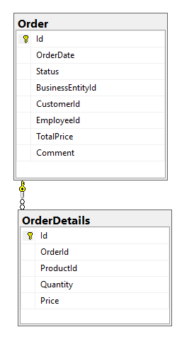
Views - Workshop
Create new view (vv_CustomerOrders) that will List all CustomerIds and sum of total Orders per customer
Change the view to show Customer Names instead of CustomerId
Change the view to show the results ordered by the customer with biggest total price
Create new view (vv_EmployeeOrders) that will List all Employees (FirstName and LastName) , Product name and total quantity sold
Alter the view to show only sales from Business entities belonging to region 'Skopski'
Suggest a question about some information that needs to be extracted from the Order details table

Slide 121
Knowledge check
Quiz, Discussion, Homework
https://sli.do/

Slide 122
Quiz
Can we have WHERE operator in the same statement with GROUP BY operator?
a. Yes
b. No
Which SQL function is used to concatenate multiple string records into single value?
a. AGG
b. CONCAT
c. STRING_AGG
d. MERGE

Slide 123
Quiz
Can we group data from multiple records without using GROUP BY function?
a. Yes
b. No
Which operator is used to filter the resultset by the result of aggregate function?
a. FILTER
b. CHECK
c. WHERE
d. HAVING
Can we have ORDER BY and HAVING operator in the same statement?
a. Yes
b. No

Slide 124
Homework 3

Slide 125
Homework requirement 1/3
Calculate the count of all grades in the system
Calculate the count of all grades per Teacher in the system
Calculate the count of all grades per Teacher in the system for first 100 Students (ID < 100)
Find the Maximal Grade, and the Average Grade per Student on all grades in the system

Slide 126
Homework requirement 2/3
Calculate the count of all grades per Teacher in the system and filter only grade count greater then 200
Calculate the count of all grades per Teacher in the system for first 100 Students (ID < 100) and filter teachers with more than 50 Grade count
Find the Grade Count, Maximal Grade, and the Average Grade per Student on all grades in the system. Filter only records where Maximal Grade is equal to Average Grade
List Student First Name and Last Name next to the other details from previous query

Slide 127
Homework requirement 3/3
Create new view (vv_StudentGrades) that will List all StudentIds and count of Grades per student
Change the view to show Student First and Last Names instead of StudentID
List all rows from view ordered by biggest Grade Count
Create new view (vv_StudentGradeDetails) that will List all Students (FirstName and LastName) and Count the courses he passed through the exam(Ispit)

Slide 128
Session 4

Slide 129
Agenda
Session 4
Homework discussion
Built-In functions
Workshop
Scalar functions
Workshop
Knowledge check (Quiz, Discussion, Homework)

Slide 130
Homework discussion

Slide 131
Built-In functions

Slide 132
Built-In functions - Declarations
Scalar variable
Table variable
Temp table
DECLARE @EmployeeId INT
SET @EmployeeId = 1
DECLARE @EmployeeList TABLE
(EmployeeId int, FirstName NVARCHAR(100), LastName NVARCHAR(100));
INSERT INTO @EmployeeList
SELECT Id, FirstName, LastName from dbo.Employee
CREATE TABLE #EmployeeList
(EmployeeId int, FirstName NVARCHAR(100), LastName NVARCHAR(100));
INSERT INTO #EmployeeList
SELECT Id, FirstName, LastName from dbo.Employee

Slide 133
Built-In functions – String functions
LEFT(), RIGHT(), LEN()
SUBSTRING
SUBSTRING ( expression ,start , length )
REPLACE
REPLACE ( string_expression , string_pattern , string_replacement )
CONCAT
Example:
select FirstName,
LEFT(FirstName,3) as LeftFunction,
RIGHT(FirstName,3) as RightFunction,
LEN(FirstName) as LenFunction,
SUBSTRING(FirstName,1,3) as SubstringFunction,
REPLACE(FirstName,'Ale','X-') as ReplaceFunction
from dbo.Employee

Slide 134
Built-In functions – Other
IS NULL, IS NOT NULL, COALESCE(), ISNULL(), NULLIF()
GETDATE(), DATEADD()
CAST, CONVERT
IF, CASE, WHILE(CONTINUE, BREAK)
DEMO:

Slide 135
Built-in functions - Workshop
Declare scalar variable for storing FirstName values
Assign value ‘Aleksandar’ to the FirstName variable
Find all Employees having FirstName same as the variable
Declare table variable that will contain EmployeeId and DateOfBirth
Fill the table variable with all Female employees
Declare temp table that will contain LastName and HireDate columns
Fill the temp table with all Male employees having First Name starting with ‘A’
Retrieve the employees from the table which last name is with 7 characters

Slide 136
Scalar functions

Slide 137
Scalar functions
User-defined functions are routines that accept parameters, perform an action, such as a complex calculation, and return the result of that action as a value.
Scalar functions allow modular programming
Scalar functions return a single data value of the type defined in the RETURNS clause
How to create:
CREATE FUNCTION FunctionName (@ParaleterList [datatype])
RETURNS [datatype]
AS
BEGIN
DECLARE @OutputVariable [datatype]
SELECT @OutputVariable = ...
RETURN @OutputVariable
END
Notes:
https://docs.microsoft.com/en-us/sql/relational-databases/user-defined-functions/user-defined-functions?view=sql-server-2017

Slide 138
Scalar functions - example
Session 4 – 01 Scalar function.sql
Example for scalar function:
CREATE FUNCTION dbo.fn_EmployeeFullName (@EmployeeID int)
RETURNS NVARCHAR(2000)
AS
BEGIN
DECLARE @Result NVARCHAR(2000)
SELECT @Result = e.FirstName + N' ' + e.LastName
FROM dbo.Employee e
WHERE Id = @EmployeeID
RETURN @Result
END
How to call:
select dbo.fn_EmployeeFullName(1)
Notes:
https://docs.microsoft.com/en-us/sql/relational-databases/user-defined-functions/user-defined-functions?view=sql-server-2017

Slide 139
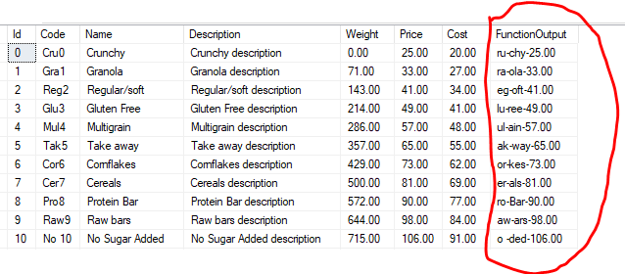
Scalar functions - Workshop
Declare scalar function (fn_FormatProductName) for retrieving the Product description for specific ProductId in the following format:
Second and Third character from the Code
-
Last three characters from the Name
-
Product Price

Slide 140
Knowledge check
Quiz, Discussion, Homework
https://sli.do/

Slide 141
Quiz
Can we assign multiple values to scalar variable?
a. Yes
b. No
Which SQL function is used to determine number of characters in the string?
a. LEFT
b. STRING
c. STRING_SIZE
d. LEN
Can we return two records in scalar function?
a. Yes
b. No

Slide 142
Quiz
Can we insert data in some table by using scalar function?
a. Yes
b. No
What is the main difference between temp table and table variable?

Slide 143
Homework 4

Slide 144
Homework requirement 1/2
Declare scalar variable for storing FirstName values
Assign value ‘Antonio’ to the FirstName variable
Find all Students having FirstName same as the variable
Declare table variable that will contain StudentId, StudentName and DateOfBirth
Fill the table variable with all Female students
Declare temp table that will contain LastName and EnrolledDate columns
Fill the temp table with all Male students having First Name starting with ‘A’
Retrieve the students from the table which last name is with 7 characters
Find all teachers whose FirstName length is less than 5 and
the first 3 characters of their FirstName and LastName are the same

Slide 145
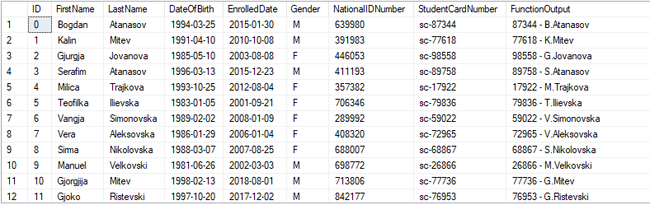
Homework requirement 2/2
Declare scalar function (fn_FormatStudentName) for retrieving the Student description for specific StudentId in the following format:
StudentCardNumber without “sc-”
“ – “
First character of student FirstName
“.”
Student LastName

Slide 146
Session 5

Slide 147
Agenda
Session 5
Homework discussion
Table valued functions
Inline table-valued function
Multi-statement table-valued functions
Workshop
Knowledge check (Quiz, Discussion, Homework)

Slide 148
Table-valued functions
Inline, Multi-statement

Slide 149
Table-valued functions
allow modular programming
Allows multiple input parameters
return table on output
Definition types:
Inline table-valued function
Multi-statement table-valued functions
Notes:
https://docs.microsoft.com/en-us/sql/relational-databases/user-defined-functions/user-defined-functions?view=sql-server-2017

Slide 150
Table-valued functions
Inline table-valued function
How to define:
Example:
Session 4 – 02 Inline TVF.sql
CREATE FUNCTION FunctionName (@ParameterList [datatype])
RETURNS TABLE
AS
RETURN
SELECT ColumnList
FROM Table
Notes:
https://docs.microsoft.com/en-us/sql/relational-databases/user-defined-functions/user-defined-functions?view=sql-server-2017

Slide 151
Table-valued functions
Multi-statement table-valued function
Allows multiple SQL Statements in the function body
How to define:
Example:
Session 4 – 03 Multi-statement TVF.sql
CREATE FUNCTION FunctionName (@ParaleterList [datatype])
RETURNS @TableVariable table (Column1, Column2,...)
AS
BEGIN
INSERT INTO @TableVariable
SELECT Column1,Column2,...
FROM TABLE1
RETURN
END
Notes:
https://docs.microsoft.com/en-us/sql/relational-databases/user-defined-functions/user-defined-functions?view=sql-server-2017

Slide 152
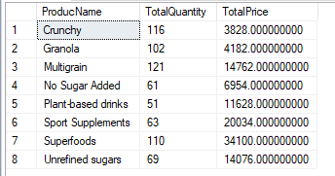
Functions - Workshop
Create multi-statement table value function that for specific BusinessEntity and Customer will return list of products sold, together with the total quantity sold and total price per product
Example resultset:

Slide 153
Differences
View
Scalar Function
Inline Table Valued Function
Multi-statement Table Valued Function

Slide 154
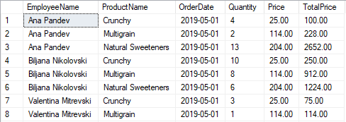
View, Inline, Multi-statement – Workshop 2
Create Scalar function (fn_OrderDetailTotalPrice) for retrieving the TotalPrice=Quantity* Price for specific OrderDetailId
Create
View (vv_EmployeeOrders)
Inline Table Valued Function (fn_EmployeeOrders_Inline)
Multi-statement Table Valued Function (fn_EmployeeOrders_MultiStatement)
that will return list of EmployeeName, ProductName, OrderDate, Quantity, Price, together with the TotalPrice (calculated with previously created scalar function) for all Female Employees and Orders in May 2019

Slide 155
Knowledge check
Quiz, Discussion, Homework
https://sli.do/

Slide 156
Quiz
Can we return single value in table-valued function?
a. Yes
b. No
Can we insert data in some table by using table valued function?
a. Yes
b. No

Slide 157
Homework 5

Slide 158
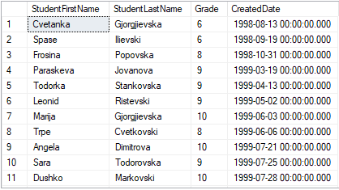
Homework requirement
Create multi-statement table value function that for specific Teacher and Course will return list of students (FirstName, LastName) who passed the exam, together with Grade and CreatedDate
Example resultset:

Slide 159
Session 6

Slide 160
Agenda
Session 6
Homework discussion
Stored procedures
Workshop
Knowledge check (Quiz, Discussion, Homework)

Slide 161
Homework discussion

Slide 162
Stored procedures

Slide 163
Stored Procedures 1/4
A T-SQL stored procedure consists of a single batch of T-SQL code. Stored procedures have a number of important features, such as the following:
They can be called from T-SQL code by using the EXECUTE command.
You can pass data to them through input parameters, and receive data back through output parameters.
They can return result sets of queries to the client application.
They can modify data in tables.
They can create, alter, and drop tables

Slide 164
Stored Procedures 2/4 - Advantages
Using T-SQL stored procedures in a SQL Server database has a number of advantages, such as the following:
To encapsulate T-SQL code
To make a database more secure
To help improve performance by creating execution plans that can be reused

Slide 165
Stored Procedures 3/4 - Declaration
CREATE PROCEDURE ProcedureName (@ParaleterList [datatype])
AS
BEGIN
DECLARE @Variable1,..N [datatype]
-- Insert statements
-- Update statements
-- Delete statements
-- Temp tables / Table variables
-- Output statements (0,1,2,..) – multiple resultsets
Select Columns
FROM Table1,...TableN
END
Session 6 - 00 StoredProcedure TestPrint.sql

Slide 166
Stored Procedures 4/4 - Example
Create procedure for adding new customer
As output from the procedure return the following data:
Total number of customers starting with the same character as the new customer
Additionally in second resultset return how many customers already exist in the new customer region
Session 6 - 01 StoredProcedure NewCustomer.sql
Session 6 - 02 StoredProcedure OutputParameter GetEmployeesByGender.sql
Session 6 - 03 StoredProcedure InsertEmployee.sql

Slide 167
Stored procedures – Workshop 1
Create procedure for inserting new product called usp_InsertProduct
Parameters
Input: Code, Name, Description, Weight, Price, Cost
Output: ProductID - ID of newly inserted record (Product)
Result set
Newly inserted Product record (Code, Name, Description, Weight, Price, Cost)
ReturnValue

Slide 168
Stored procedures – Workshop 2
Create new procedure called CreateOrder
Procedure should create only Order header info (not Order details)
Procedure should return the total number of orders in the system for the Customer from the new order (regardless the BusinessEntity)
Procedure should return second resultset with the total amount of all orders for the customer and business entity on input
Insert few orders in the system

Slide 169
Stored procedures – Workshop 2
Create new procedure called CreateOrderDetail
Procedure should take the single price for item from Product table (Price column)
Procedure should add details for specific order (new record for new Product/Quantity for specific order)
When the order detail is inserted procedure should correct the TotalPrice column in the main table (dbo.order)
Output from this procedure should be resultset with order details in a form of pairs: ProductName and TotalPrice per product (Price*Quantity)
Insert few order details for some orders
Session 5 workshop - 01 Stored Procedures.sql

Slide 170
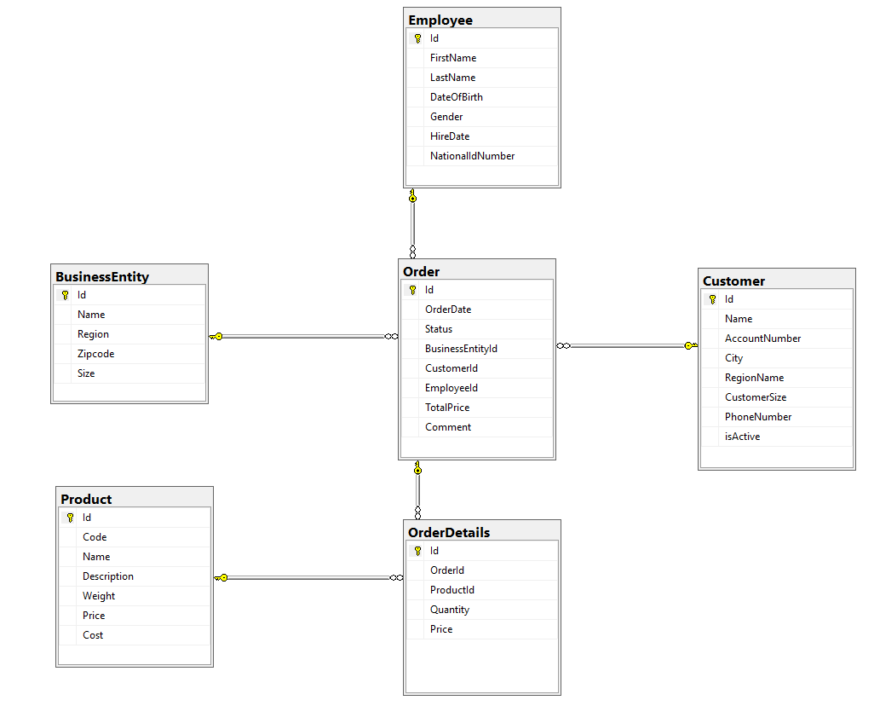
Have the structure of tables in mind
when creating the procedures

Slide 171
Knowledge check
Quiz, Discussion, Homework

Slide 172
Quiz
Can we have stored procedure without input parameters and with two output result sets?
a. Yes
b. No
Can we use temp tables inside stored procedure?
a. Yes
b. No

Slide 173
Quiz
Can we have stored procedure without resultset on output?
a. Yes
b. No
What is the main difference between stored procedure and table valued function?

Slide 174
Homework 6

Slide 175
Homework requirement 1a
Create new procedure called CreateGrade
Procedure should create only Grade header info (not Grade Details)
Procedure should return the total number of grades in the system for the Student on input (from the CreateGrade)
Procedure should return second resultset with the MAX Grade of all grades for the Student and Teacher on input (regardless the Course)

Slide 176
Homework requirement 1b
Create new procedure called CreateGradeDetail
Procedure should add details for specific Grade (new record for new AchievementTypeID, Points, MaxPoints, Date for specific Grade)
Output from this procedure should be resultset with SUM of GradePoints calculated with formula AchievementPoints/AchievementMaxPoints*ParticipationRate for specific Grade

Slide 177
Session 7

Slide 178
Agenda
Session 7
Homework discussion
Error handling
Workshop
Basic administration
Backups
Permissions
Knowledge check (Quiz, Discussion, Homework)
Summary

Slide 179
Error handling

Slide 180
Bug, Error, Exception
A bug is a programmer mistake that should be fixed before the code is made available to users.
An error is caused by user action. The user might enter a number where a letter is expected. An error might cause an exception, but you can prevent that by implementing code to validate user input.
Exceptions are raised as a result of problems that you can predict, but can’t prevent, because they depend on factors outside your program. A network connection dropping suddenly, or running out of disk space...

Slide 181
TRY … CATCH
BEGIN TRY
{ sql_statement | statement_block }
END TRY
BEGIN CATCH
[ { sql_statement | statement_block } ]
END CATCH
https://docs.microsoft.com/en-us/sql/t-sql/language-elements/try-catch-transact-sql
Very useful when you want to handle Error messages. Usually used in Stored procedures and Triggers.

Slide 182
Retrieving Error Information
In the scope of a CATCH block, the following system functions can be used to obtain information about the error that caused the CATCH block to be executed:
ERROR_NUMBER() returns the number of the error.
When called in a CATCH block, ERROR_NUMBER returns the error number of the error that caused the CATCH block to run
ERROR_SEVERITY() returns the severity.
Severity levels 11 to 16 are generated as a result of user problems and can be fixed by the user. For example, the error message returned in the invalid update query, used earlier, had a severity level of 16.

Slide 183
ERROR_STATE() returns the error state number.
When called in a CATCH block, returns the state number of the error message that caused the CATCH block to be run.
Returns NULL if called outside the scope of a CATCH block.
ERROR_PROCEDURE() returns the name of the stored procedure or trigger where the error occurred.
When called in a CATCH block, ERROR_PROCEDURE returns the name of the stored procedure or trigger in which the error originated.
ERROR_LINE() returns the line number inside the routine that caused the error.
When called in a CATCH block, ERROR_LINE returns
the line number where the error occurred
the line number in a routine, if the error occurred within a stored procedure or trigger
NULL, if called outside the scope of a CATCH block.

Slide 184
ERROR_MESSAGE() returns the complete text of the error message. The text includes the values supplied for any substitutable parameters, such as lengths, object names, or times.
CREATE PROCEDURE usp_ExampleProc
AS
SELECT 1/0;
GO
BEGIN TRY
-- Execute the stored procedure inside the TRY block.
EXECUTE usp_ExampleProc;
END TRY
BEGIN CATCH
SELECT
ERROR_NUMBER() AS ErrorNumber
,ERROR_SEVERITY() AS ErrorSeverity
,ERROR_STATE() AS ErrorState
,ERROR_PROCEDURE() AS ErrorProcedure
,ERROR_LINE() AS ErrorLine
,ERROR_MESSAGE() AS ErrorMessage;
END CATCH;
GO
Session 5 – 02 Error handling.sql

Slide 185
Error handling - Workshop
Add error handling on CreateOrderDetail procedure
Test the error handling by inserting not-existing values for ProductId
Add error handling on InsertProduct procedure
Test the error handling by inserting duplicate value for Product Code
Add error handling on InsertEmployee procedure
Test the error handling by inserting duplicate value for Employee NationalIdNumber
Session 7 workshop - 01 Add error handling on OrderDetails.sql
Session 7 workshop - 02 Add error handling on InsertProduct.sql
Session 7 workshop - 03 Add error handling on InsertEmployee.sql

Slide 186
Basic administration

Slide 187
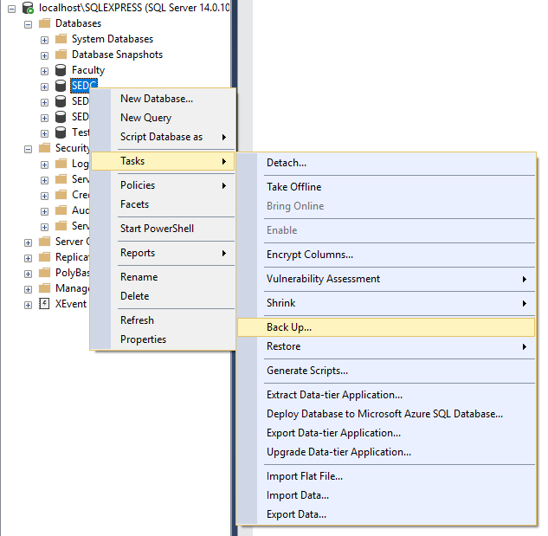
Database backups
Explain the concept of database backups
Try to backup SEDC database on your PC
Notes:
https://docs.microsoft.com/en-us/sql/relational-databases/user-defined-functions/user-defined-functions?view=sql-server-2017

Slide 188
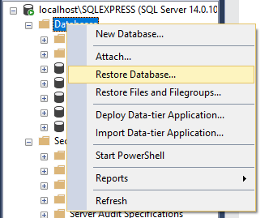
Database Restore
Explain the concept of database backups
Try to restore database on your SQL server

Slide 189
Permissions
Server logins
Create new login
Map the login to specific roles
Map the login to specific databases
Test the new login
Notes:
https://docs.microsoft.com/en-us/sql/relational-databases/user-defined-functions/user-defined-functions?view=sql-server-2017

Slide 190
Knowledge check
Quiz, Discussion, Homework

Slide 191
Quiz
Can we use select statements inside error handling blocks?
a. Yes
b. No
Explain the main purpose of database backups
Explain the main purpose of users and logins

Slide 192
Homework 7

Slide 193
Homework requirement 1/1
Add error handling on CreateGradeDetail procedure
Test the error handling by inserting not-existing values for AchievementTypeID

Slide 194
Thank you

